Slide 1
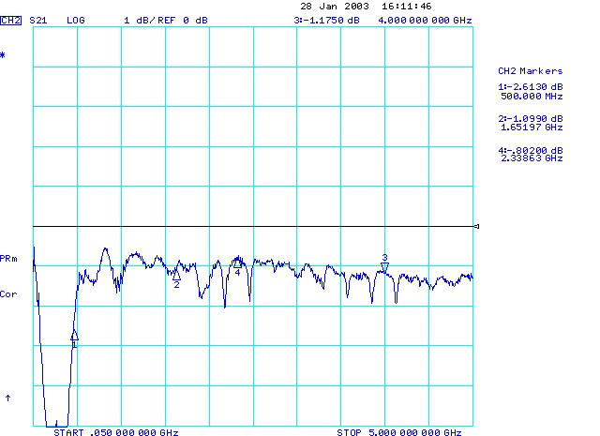
No Absorber Or Cover

Slide 2
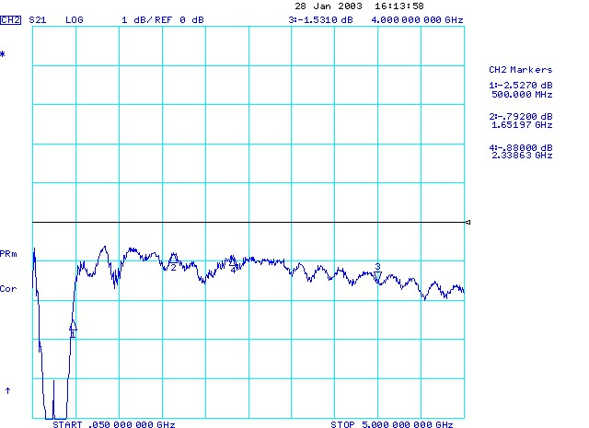
Absorber On Top + Absorber On Bottom; No Cover

Slide 3
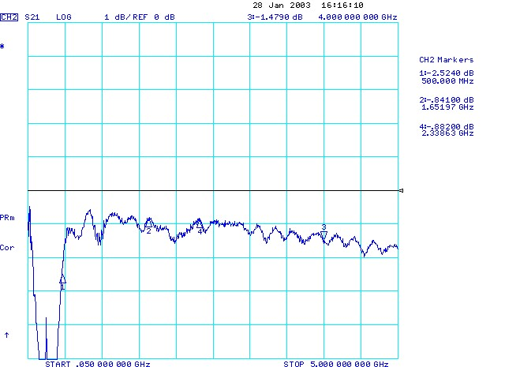
Absorber On Bottom; No Cover

Slide 4
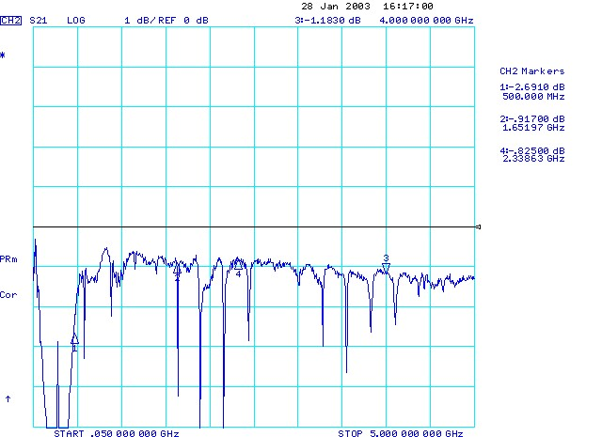
Cover On; No Absorber

Slide 5
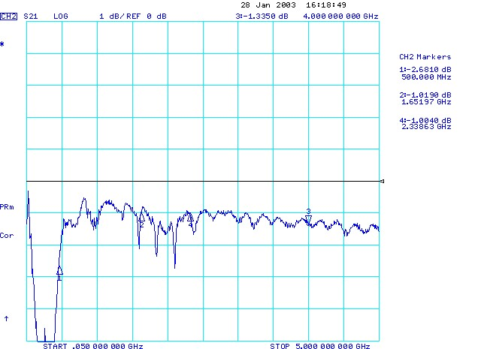
Cover On; Bottom Absorber On

Slide 6

Cover On; Bottom & Top Absorber

Slide 7
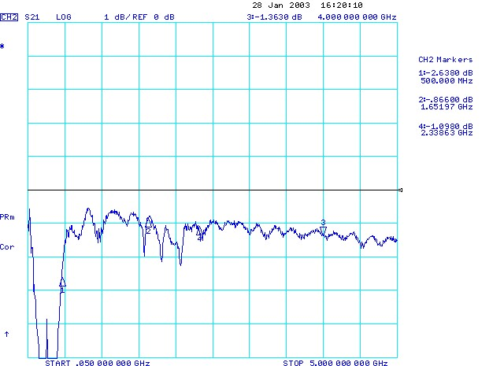
Cover On; Top Absorber

Slide 8
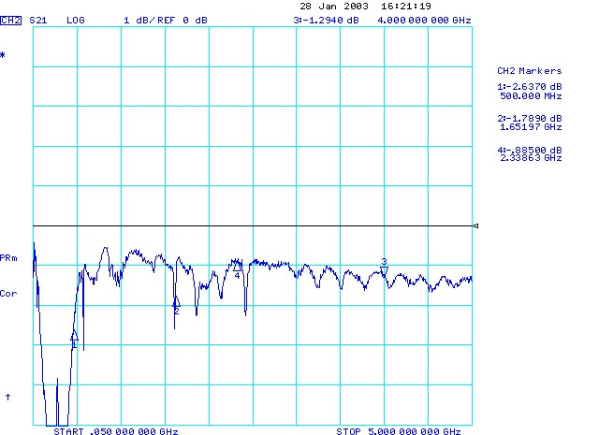
Cover On; Both Absorbers On Bottom

Slide 9
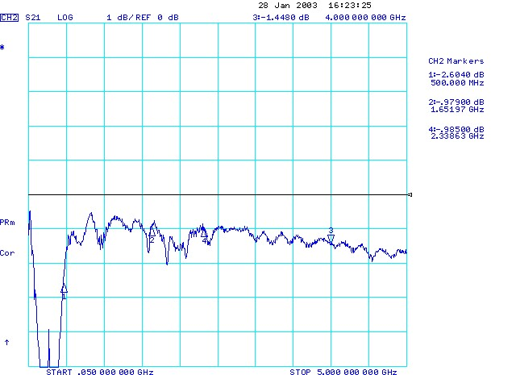
Cover On; Both Absorbers On Top

Slide 10
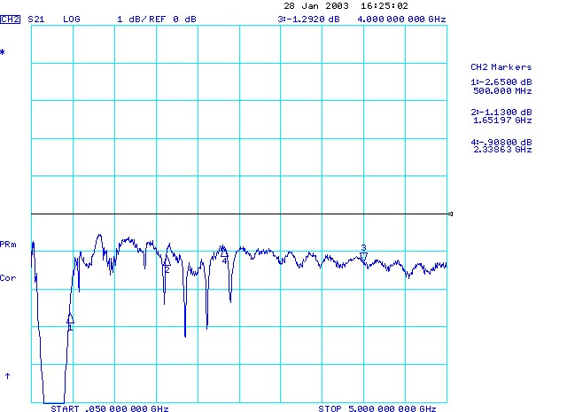
Cover On; Gold/Mica @ Edge

Slide 11
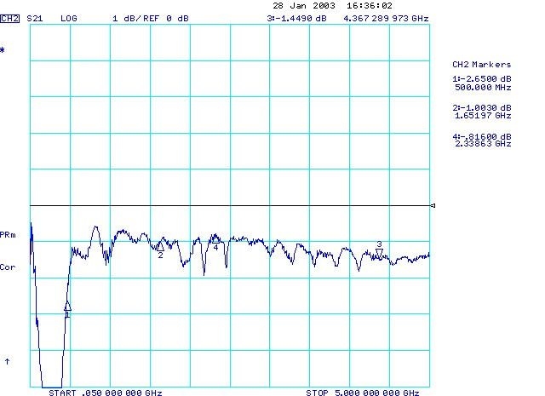
No Cover; Gold/Mica @ Edge

Slide 12
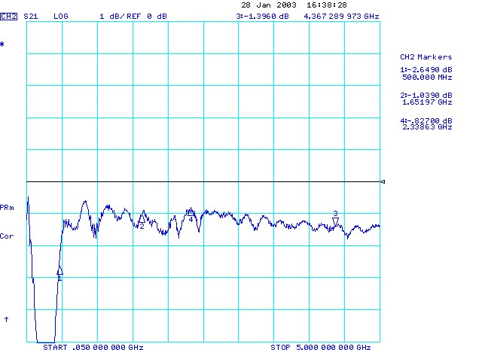
No Cover ; Gold/Mica Above Wide Part Of Balun

Slide 13

Cover On; Gold/Mica Above Wide Part Of Balun

Slide 14
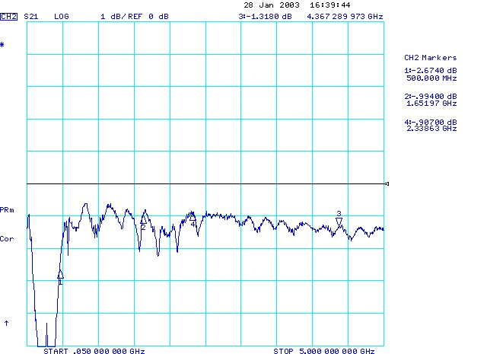

Slide 15
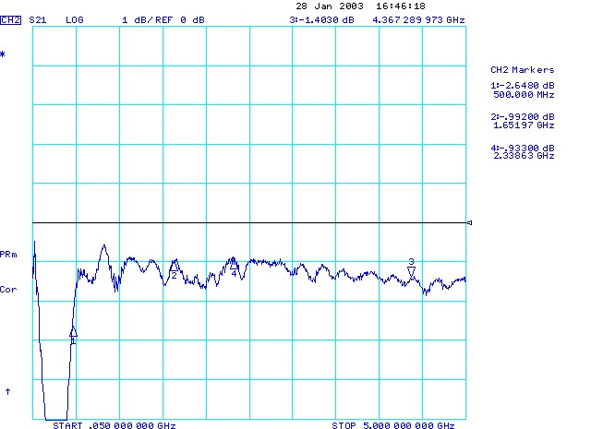
No Cover; Gold/Mica Above Wide Parts Of Both Baluns

Slide 16
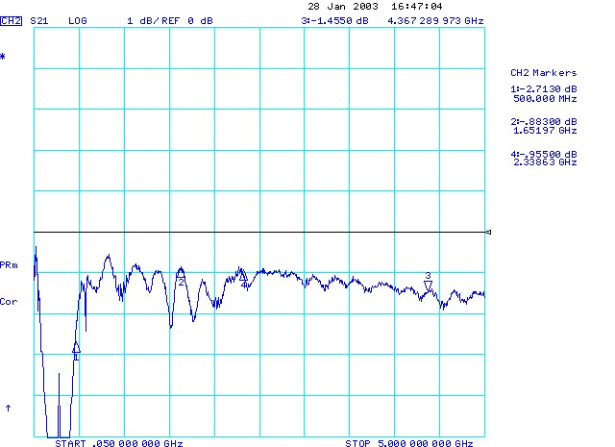
Cover On; Gold/Mica Above Wide Parts Of Both Baluns

Slide 17
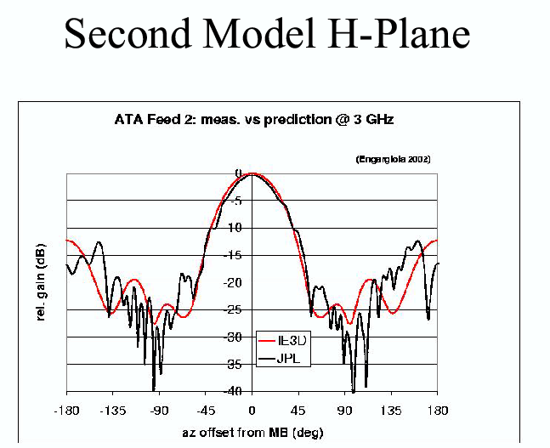

Slide 18
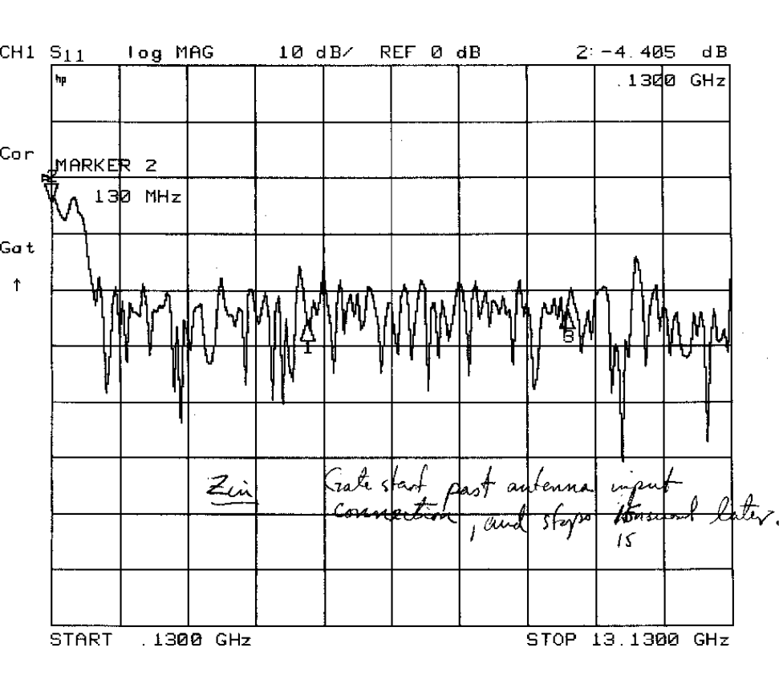
Feed Tests
Excellent (16 dB) match
Agrees with EM calcs on
Impedance
Gain
Internal Loss

Slide 19
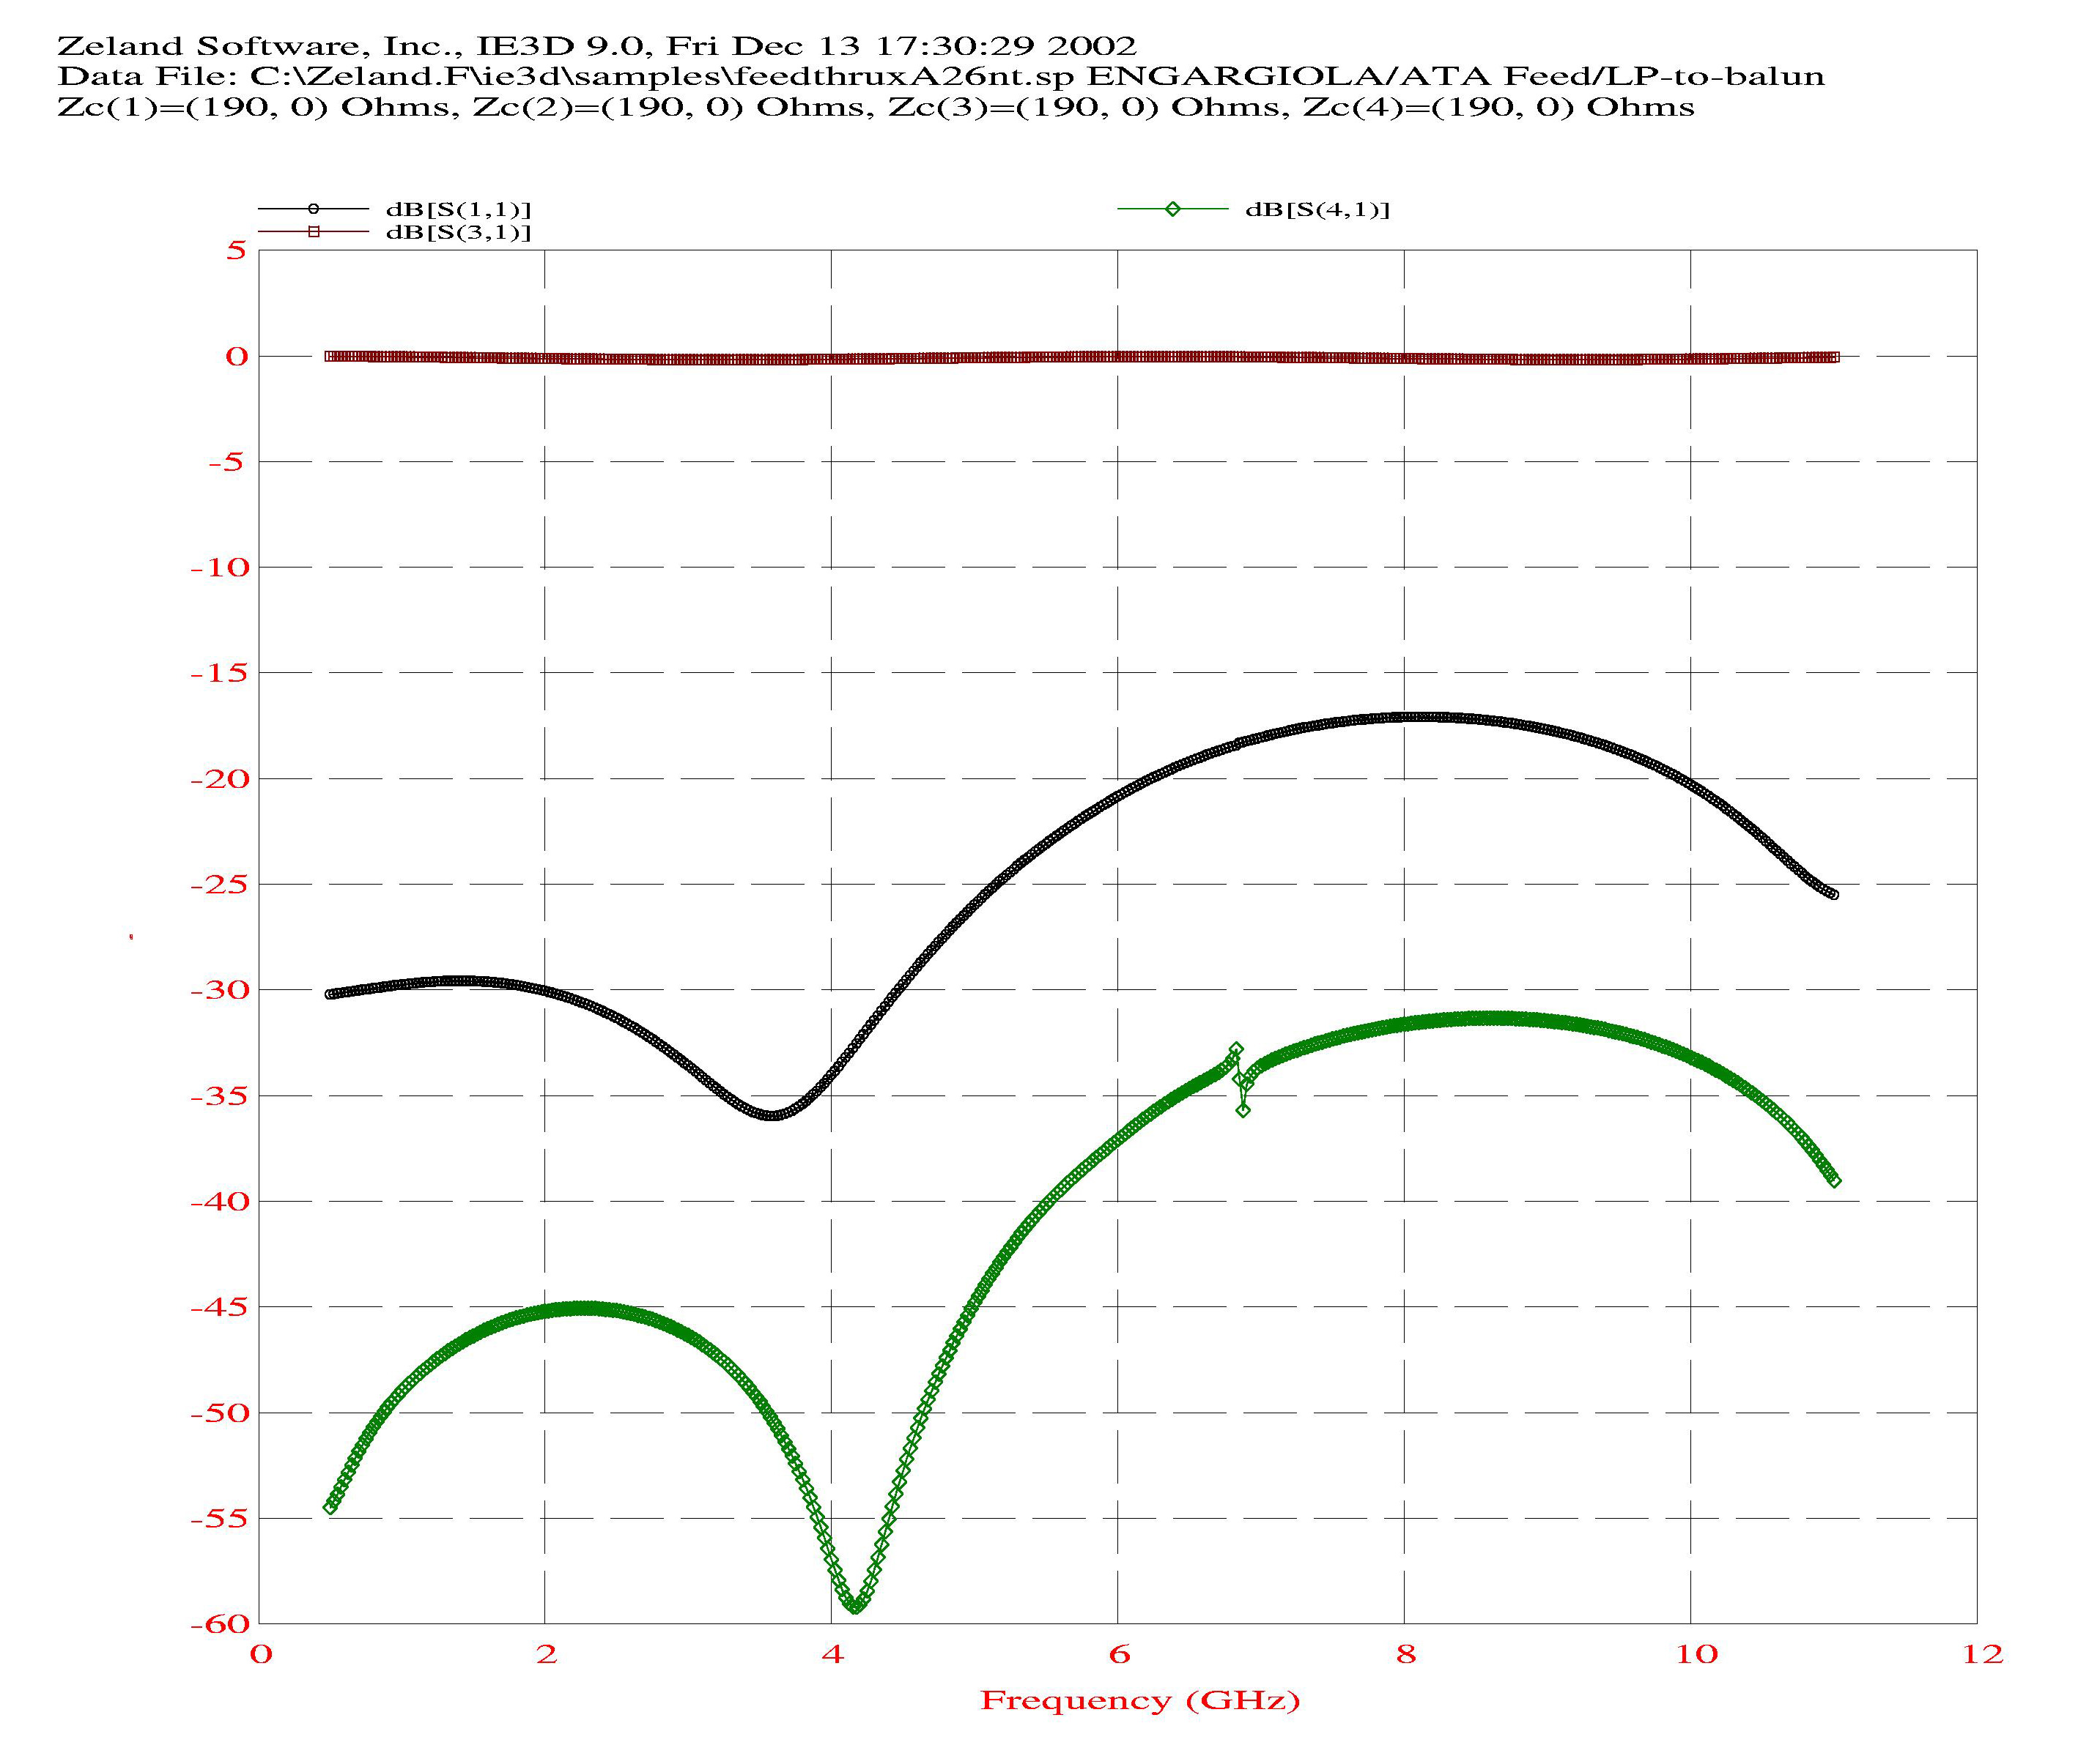
Input Match and Cross Talk

Slide 20
Feed Properties
Input impedance
  <Z_{in}>=206 Ohms
  S_{max}=1.35
Spillover
Θ | Spillover
42º | 18%
90º | 8.5%
135º | 3%

